Slide 1
Road Traffic Signs, Signals and Markings.
The purpose of road traffic signs is to regulate traffic in such a way that traffic flow and road traffic safety are promoted.

Slide 2
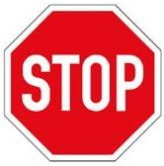
Name: Stop Sign Purpose: To bring traffic to a stop.
What must you do:
Bring your vehicle to a stop behind the stop line.
If there is no stop line, the front of the vehicle must come to a stand still in line with the stop sign.
At a three or four way stop, you may not move off before all the other vehicles which stopped before you have moved off.
Proceed only when it is safe.

Slide 3

Name: Yield Sign Purpose: To indicate that you must yield to other traffic.
What must you do:
If other traffic is approaching the intersection, reduce speed and, if necessary, stop.

Slide 4
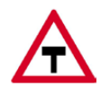
Name: T-Junction Sign Purpose: To warn that you are approaching an intersection where you have to turn sharp to the right or left.
What must you do:
Look out for cross-traffic. Slow down and be prepared to stop and go round the corner at a safe speed.

Slide 5
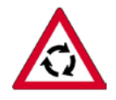
Name: Traffic Circle Sign Purpose: To warn that there is a traffic circle ahead where you may need to yield to other traffic.
What must you do:
Slow down so that you can stop or drive around the circle at a safe speed.
Look out for road traffic signs and markings which will tell you whether you have the right of way or whether you have to yield.
If there is no indication you have to give way to traffic approaching from the right.
Vehicles within a traffic circle have right of way.
If you have right of way still look out for traffic in the circle which may not yield to you.
If a Yield Sign is displayed at the traffic circle, you must yield to any driver who crosses his yield line first before you cross yours.

Slide 6
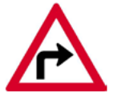
Name: Sharp Curve Sign Purpose: To warn that there is a sharp curve ahead to the left or right.
What must you do:
Slow down so that you can take the curve safely or stop within the distance that you can see.

Slide 7
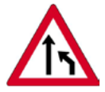
Name: Lane Ends Sign Purpose: To warn that the double-lane road you are driving on narrows by a full lane from the right hand side.
What must you do:
Depending on which sign is displayed, change in good time to the lane that carries on.

